Slide 1
Managing Stepwise Process for Improving the Quality of HIV Rapid Testing and Recency eTools for RTCQI
Laboratory Data Monitoring Team
International Branch, CDC Atlanta
RTCQI Best Practices Workshop-Western Hemisphere

Slide 2
Agenda
Overview of SPI-RRT Data Management
Roles and Responsibilities of Stakeholders
Data Flow and Management Overview
Integration with Data Management Tools
Live Demonstration of the Data Tool

Slide 3
Overview
The SPI-RRT checklist has been instrumental in setting minimum standards across all HIV RT/RTRI testing points, guiding facilities toward continuous quality improvement. By employing the checklist, facilities have been able to identify quality gaps and areas needing enhancement to meet national quality standards.
eTool for SPI-RRT helps:
Transform: Transforms the checklist from a paper-based to a tablet-based system, simplifying data collection and enabling real-time insights through an interactive dashboard.
Assist: Assists the quality manager in planning and managing site inspection, enhancing resource allocation, and reviewing audit results via the dashboard.
Highlight: Highlight specific areas where improvements are necessary, allowing facilities to focus on these areas for better compliance and performance.

Slide 4
Stakeholders and Their Roles
Quality Manager:
Primarily responsible for managing the audit process and assisting in stepwise improvement. This includes selecting the site’s inspection calendar, reviewing inspection results, and working with the site to improve.
Auditors:
Visit the site to review the current state of RT/RRT testing.
Collect data using the tablet-based survey tool.
Compile and sync data for the dashboard via the tablet.
Testing Sites/Laboratories:
Participate in the site inspection process.
Work on received feedback to improve

Slide 5
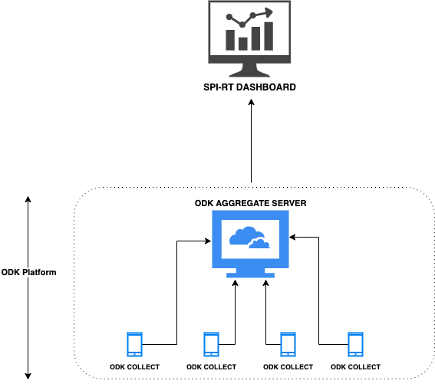
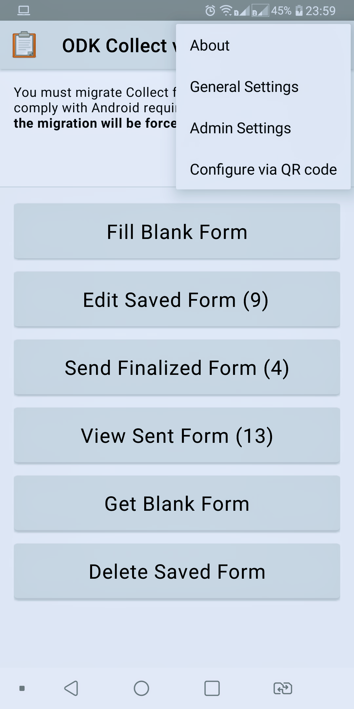
Data Flow and Management
Flowchart Description:

Slide 6
Implementation Considerations
Tablet and Dashboard Differences:
Tablet and Dashboard are two different applications.
The country can use only Tablets if Dashboard resources are unavailable.
Server Requirements:
SPI-RRT eTools require two different servers:
One to collect tablet data.
One for the Dashboard.
The Dashboard can be deployed with other tools, such as ePT, Tester certification, and logbook.
Previously, a free Google server was used, but it is no longer available.
ODK Tablet Customization:
The ODK Tablet version is easy to customize and change.
It does not require any IT skills.
Changes in the ODK Tablet can have a cascading effect on the Dashboard, requiring an update.

Slide 7
Effectiveness and Integration
Key Benefits:
Efficiency: Streamlines the site audit process, reducing manual effort and the time required for tasks.
Accuracy: Enhances the timeliness and precision of collected data.
Support for Testers: Improves the provision of timely and relevant information to testers, enhancing their training and certification experience.
Integration:
Tester Certification System: Integrates SPI-RRT eTools with tester certifications, creating a cohesive management system that aligns site needs with tester qualifications.
Proficiency Testing (PT) Linkage: Connects proficiency test results directly with site audits to ensure the quality of testing.
Integration with Logbook: SPIRRT results can be linked to logbook data management, providing a comprehensive view of each testing site. Reporting Improvements:
Provides accurate reports at the district, national, and partner levels, facilitating better decision-making and policy formulation.

Slide 8
Live Demo - Scenario Overview
Country: Healthland
District: Medville
Partners: HealthPartners Global
SPI-RRT Audit:
The National Reference Laboratory is responsible for the quality of testing.
Audit Requirements: HIV rapid testing sites must undergo two audits each year.
Event Example:
The National Reference Laboratory is working with HealthPartners Global:
Conducting a certification workshop for HIV testers.
Hosting practical testing sessions to assess hands-on skills.
Administering written exams both online and on paper to evaluate theoretical knowledge.
eTool Usage:
HealthPartners Global's Role: Conduct audits for multiple sites under the guidance of the National Reference Laboratory.
The National Reference Laboratory reviews the audit data.
Integration Highlights:
Link with Tester Certification: Illustrates how the tool connects tester certification processes with individual tester certifications.
Proficiency Testing (PT) Linkage: Demonstrates the integration of PT results directly with site audits.
Demo Objectives:
This demo will walk you through a complete cycle from site audit using eTools, including a dashboard demonstration using the scenario outlined.
It will showcase practical data entry, management, and reporting functions within the tool across different organizational levels.

Slide 9
Ready to Collaborate and Enhance?
Engage:
Please feel free to ask any questions now provide Feedback:
Share your thoughts on how we can improve or adapt these tools for better efficiency.
Plan Next Steps:
We are here to support you every step of the way. Let’s schedule a follow-up to discuss specific implementation strategies.
Stay Connected:
For further inquiries or additional information, don’t hesitate to contact me.
Email: app0@cdc.gov
Let's dive deeper into any aspects you're interested. Please visit us at IT Booth.

Slide 10
Thank You

